Slide 1
Bachelor Of Engineering In Information Technology Semester Three, Second Year(Odd semester) 14th July 2025 to 22nd November 2025
Padre Conceicao College of Engineering
Verna Goa 403722 India

Slide 2
App Development
SEC-241
22nd July 2025

Slide 3
UNIT 1 :Javascript
Sr.No | Title
1 | Introduction to client side scripting
2 | documents
3 | forms
4 | statements
5 | comments
6 | variables
7 | operators
8 | conditional statements
9 | loops
10 | events
11 | objects
12 | functions

Slide 4
What is JavaScript?
JavaScript is a text-based programming language
JavaScript is used both on the client-side and server-side that make web pages interactive.
Javascript is used by programmers across the world to create dynamic and interactive web content like applications and browsers.
JavaScript is so popular that it's the most used programming language in the world, used as a client-side programming language by 97.0% of all websites.

Slide 5
Java language v/s JavaScript Language
Sr.No | Java language | JavaScript Language
1 | It is a Programming language. | It is a scripting language.
2 | It is one of the complex languages to learn. | It one of the easy languages to learn.
3 | It requires a large amount of memory. | It does not require large amount of memory.
4 | Java is stored on the host machine as the "Byte" code. | JavaScript is stored on the Host machine (client Machine) as the "source" text.
5 | Java is a pure Object Oriented Programming Language. | JavaScript is Object-Based Language.
6 | Java is a Standalone language. | JavaScript is not a standalone language, as it needs to be integrated into an HTML program for execution.
7 | Java program should be compiled before execution. | JavaScript needs to be integrated into the HTML program for the execution.
8 | The web-browser is not required to run java programs. | The web-browser is essential to run the JavaScript programs.

Slide 6
Java language v/s JavaScript Language
Sr.No | Java language | JavaScript Language
9 | Java is a strongly typed language, which means that the user has to decide the data type of the variable before declaring and using it. Example "int a", the variable "a" can store the value of integer type only. | JavaScript is a loosely typed language, which means that the user does not have to worry about the data-type of the variable before and after the declaration. Example "var a", the "a" variable can store the value of any data-type.
10 | In Java, by utilizing the Multi-threading, users can perform complicated tasks. | In JavaScript, user is not able to perform complicated tasks.
11 | Java programming language was developed by the "Sun Microsystems." | JavaScript programming language was developed by the "Netscape."
12 | In Java programming language, programs are saved with the ".java" extension. | On the other hand, programs in JavaScript are saved with the ".js" extension.

Slide 7
Advantages of JavaScript
Gives the ability to create rich interfaces.
Popularity: JavaScript is used everywhere on the web
Simplicity: JavaScript is relatively simple to learn and implement.
Server Load: Being client-side reduces the demand on the website server.
Interoperability: JavaScript has the ability to support all modern browsers and produce an equivalent result.
Speed: Client-side JavaScript is very fast because it can be run immediately within the client-side browser. Unless outside resources are required, JavaScript is unhindered by network calls to a backend server.
Less Bandwidth: Regardless of where you host JavaScript, it always gets executed on client environment to save lots of bandwidth and make execution process fast.

Slide 8
Advantages of JavaScript
8.Global companies support community development by creating projects that are important. An example is Google (created Angular framework) or Facebook (created the React.js framework).
9.In JavaScript, XMLHttpRequest is an important object that was designed by Microsoft. The object call made by XMLHttpRequest as a asynchronous HTTP request to the server to transfer the data to both sides without reloading the page
10.There are some ways to use JavaScript through Node.js servers. It is possible to develop a whole JavaScript app from front to back using only JavaScript.

Slide 9
Disadvantages of JavaScript
Client-Side Security: Because the code executes on the users’ computer, in some cases it can be exploited for malicious purposes. This is one reason some people choose to disable Javascript.
Browser Support: JavaScript is sometimes interpreted differently by different browsers. This makes it somewhat difficult to read and write cross-browser code.
No matter what proportion fast JavaScript interpret, JavaScript DOM (Document Object Model) is slow and can be never fast rendering with HTML.
If the error occurs in the JavaScript, it can stop to render the whole website. Browsers are extremely tolerant of JavaScript errors.
This continuous conversions takes longer in conversion of number to an integer. This increases the time needed to run the script and reduces its speed

Slide 10
Disadvantages of JavaScript
6.This may be difficult to develop large applications, although you’ll also use the TypeScript overlay.
7.This applies to larger front-end projects. The configuration is often a tedious task to the amount of tools that require to figure together to make an environment for such a project. This is often directly associated with the library’s operation.
8.The main problem or disadvantage in JavaScript is that the code is always visible to everyone anyone can view JavaScript code.
9.Though some HTML editors support debugging, it’s not as efficient as other editors like C/C++ editors . Hence difficult for the developer to detect the matter

Slide 11
Introduction to client side scripting
Client-side scripting generally refers to the class of computer programs on the web that are executed client-side, by the user’s web browser, instead of server-side (on the web server).
This type of computer programming is an important part of the Dynamic HTML (DHTML) concept, enabling web pages to be scripted; that is, to have different and changing content depending on user input, environmental conditions (such as the time of day), or other variables.
These kinds of scripts are small programs which are downloaded , compiled and run by the browser.
JavaScript is an important client-side scripting language and widely used in dynamic websites.

Slide 12
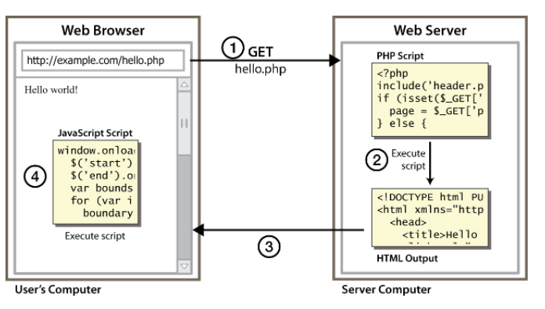
client side scripting

Slide 13
Client Side scripting v/s Server Side scripting
Sr.No | Client-Side scripting | Server-Side scripting
1 | It runs on the user’s computer. | It runs on the webserver.
2 | Source code is visible to the user | Source code is not visible to the user because its output of server-sideside is an HTML page.
3 | It does not provide security for data. | It provides more security for data.
4 | It usually depends on the browser and its version. | In this any server-side technology can be used and it does not depend on the client.
5 | It is a technique used in web development in which scripts run on the client’s browser. | It is a technique that uses scripts on the webserver to produce a response that is customized for each client’s request.
6 | There are many advantages linked with this like faster response times, a more interactive application. | The primary advantage is its ability to highly customize, response requirements, access rights based on user.
7 | HTML, CSS, and javascript are used. | PHP, Python, Java, Ruby are used.

Slide 14
Internal and External JavaScript
You can use JavaScript code in two ways.
Internal: You can either include the JavaScript code internally within your HTML document itself
External: You can keep the JavaScript code in a separate external file and then point to that file from your HTML document.

Slide 15
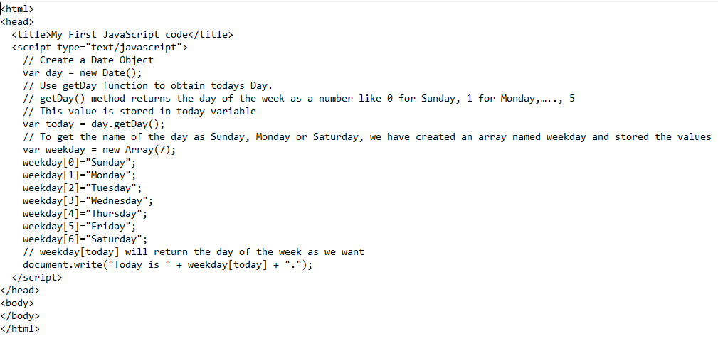

Example of Internal JavaScript?
day.htm
output

Slide 16
What is External JavaScript?
You decide to display the current date and time in all your web pages. If you wrote the code and copied in all your web pages (eg 100 pages),but later, you want to change the format in which the date or time is displayed.
In this case, you will have to make changes in all the 100 web pages. This will be a very time consuming and difficult task.
Therefore, save the JavaScript code in a new file with the extension .js. It is assumed that the .js file and all your web pages are in the same folder. If the external.js file is in a different folder, you need to specify the full path to your file in the src attribute.
Then, add a line of code in all your web pages to point to your .js file like this <script type="text/javascript" src="currentdetails.js">

Slide 17
How to Link HTML file to an external JavaScript file
script tag should be placed in HTML page's head
script code is stored in a separate .js file
JS code can be placed directly in the HTML file's body or head (like CSS)
but this is bad style (should separate content, presentation, and behavior)
Syntax
<script src="filename" type="text/javascript"></script>
Example
<script src="example.js" type="text/javascript"></script>

Slide 18
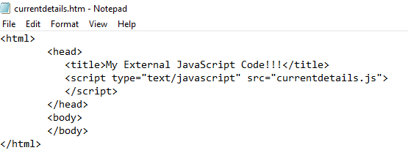

currentdetails.htm and Output
output

Slide 19
When to Use Internal and External JavaScript Code?
If you have only a few lines of code that is specific to a particular webpage, then it is better to keep your JavaScript code internally within your HTML document.
On the other hand, if your JavaScript code is used in many web pages, then you should consider keeping your code in a separate file.
In that case, if you wish to make some changes to your code, you just have to change only one file which makes code maintenance easy.
If your code is too long, then also it is better to keep it in a separate file. This helps in easy debugging.

Slide 20
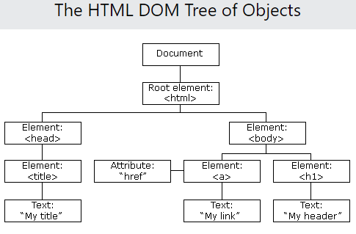
Document Object Model (DOM)
When a web page is loaded, the browser creates a DOM of the page. The HTML DOM model is constructed as a tree of Objects:

Slide 21
What is the DOM?
The DOM is a W3C (World Wide Web Consortium) standard. The DOM defines a standard for accessing documents: "The W3C Document Object Model (DOM) is a platform and language-neutral interface that allows programs and scripts to dynamically access and update the content, structure, and style of a document."
The W3C DOM standard is separated into 3 different parts:
Core DOM - standard model for all document types
XML DOM - standard model for XML documents
HTML DOM - standard model for HTML documents

Slide 22
What is the HTML DOM?
The HTML DOM is a standard object model and programming interface for HTML. It defines:
The HTML elements as objects
The properties of all HTML elements
The methods to access all HTML elements
The events for all HTML elements
In other words: The HTML DOM is a standard for how to get, change, add, or delete HTML elements.

Slide 23
What can JavaScript create with DOM?
With the object model, JavaScript gets all the power it needs to create dynamic HTML:
JavaScript can change all the HTML elements in the page
JavaScript can change all the HTML attributes in the page
JavaScript can change all the CSS styles in the page
JavaScript can remove existing HTML elements and attributes
JavaScript can add new HTML elements and attributes
JavaScript can react to all existing HTML events in the page
JavaScript can create new HTML events in the page

Slide 24
JavaScript Forms
JavaScript Form Validation: HTML form validation can be done by JavaScript.
Example: If a form field (fname) is empty, this function alerts a message, and returns false, to prevent the form from being submitted

Slide 25
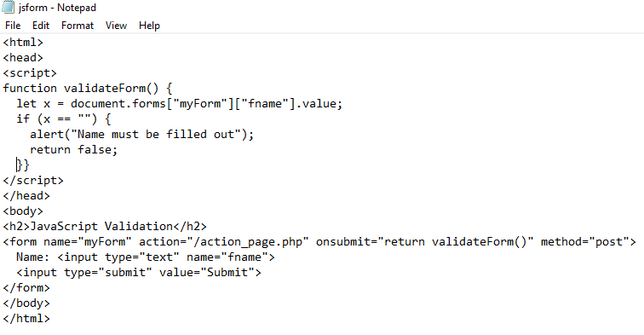
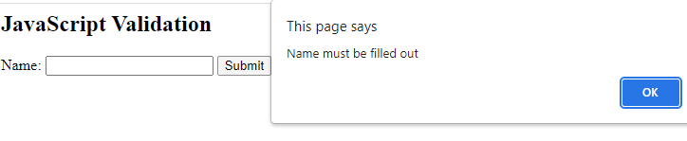
HTML form validation by JavaScript
jsform.htm
output

Slide 26
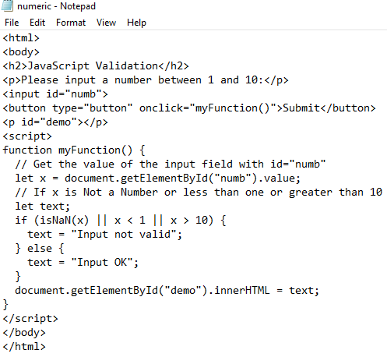
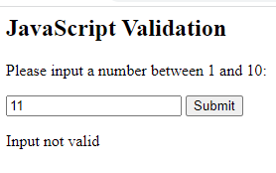
JavaScript Can Validate Numeric Input
numeric.htm
output

Slide 27
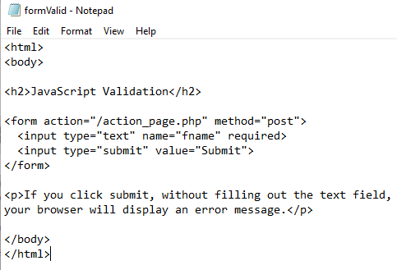
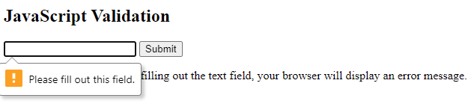
Automatic HTML Form Validation
formValid.htm
output

Slide 28
Data Validation
Data validation is the process of ensuring that user input is clean, correct, and useful.
Typical validation tasks are:
has the user filled in all required fields?
has the user entered a valid date?
has the user entered text in a numeric field?
Validation can be defined by many different methods, and deployed in many different ways.
Server side validation is performed by a web server, after input has been sent to the server.
Client side validation is performed by a web browser, before input is sent to a web server.

Slide 29
JavaScript Statements
JavaScript statements are composed of:
Values
Operators
Expressions
Keywords
Comments.
A JavaScript program is a list of programming statements. Most JavaScript programs contain many JavaScript statements. The statements are executed, one by one, in the same order as they are written. JavaScript programs (and JavaScript statements) are often called JavaScript code.

Slide 30
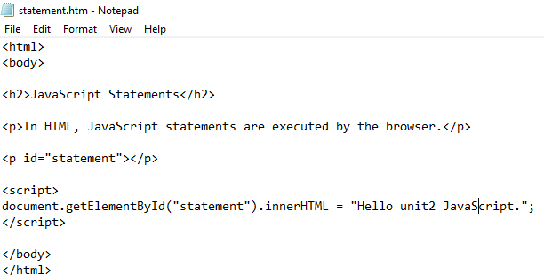
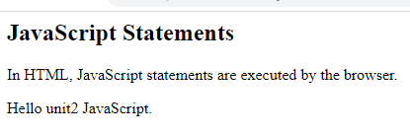
JavaScript Statements
This statement tells the browser to write "Hello unit2 JavaScript." inside an HTML element with id=“statement":
output

Slide 31
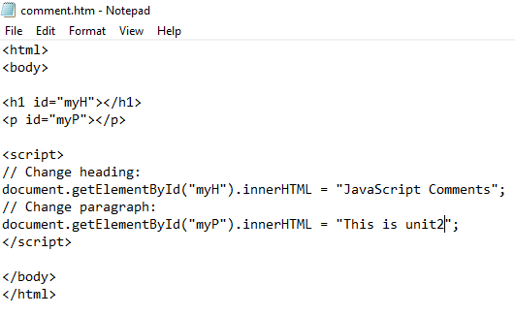

Comments
single line comment start with //
Any text between // and the end of the line will be ignored by Javascript and will not be executed.
output

Slide 32
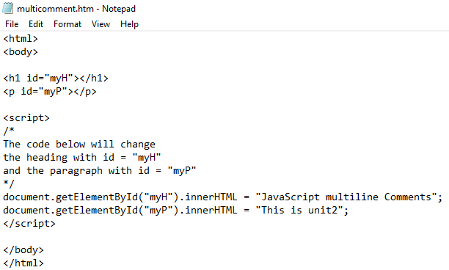

Comments
Multi-line Comments start with /* and end with */
Any text between /* and */ will be ignored by JavaScript
output

Slide 33
Variables
Variables are containers for storing data
4 Ways to Declare a JavaScript Variable:
Using var
Using let
Using const
Using nothing
Examples
var name = expression;
var age = 32;
var weight = 127.4;
var clientName = "Connie Client";

Slide 34
When to Use JavaScript var?
Always declare JavaScript variables with var,let, or const.
The var keyword is used in all JavaScript code from 1995 to 2015.
The let and const keywords were added to JavaScript in 2015.
If you want your code to run in older browser, you must use var.

Slide 35
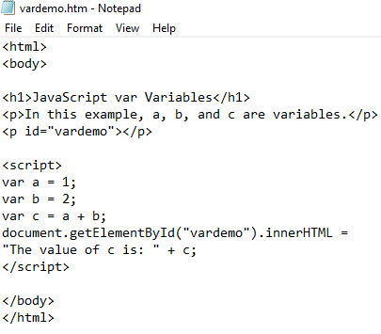
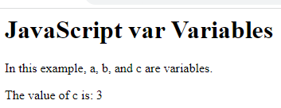
Variables declared using Var keyword
In the below example,a,b and c variables are declared using the var keyword
output

Slide 36
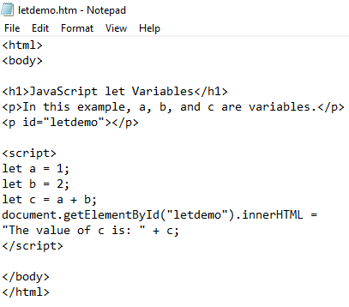
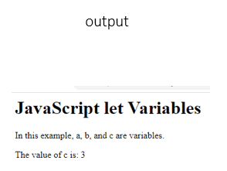
When to Use JavaScript let?
If you think the value of the variable can change, use let.

Slide 37
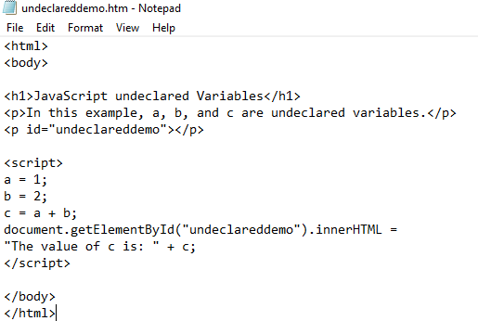
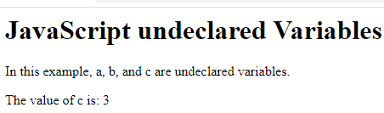
Variables declared using nothing
output

Slide 38
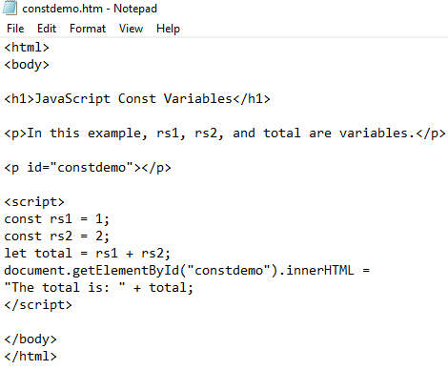
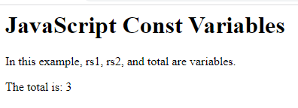
When to Use JavaScript const?
If you want a general rule: always declare variables with const.
In this example, rs1, rs2 are constant values and cannot be changed. variable total is declared with Let keyword. Its value can be changed.
output

Slide 39
JavaScript Arithmetic Operators
Sr.No | Operator | Description
1 | + | Addition
2 | - | Subtraction
3 | * | Multiplication
4 | ** | Exponentiation
5 | / | Division
6 | % | Modulus (Division Remainder)
7 | ++ | Increment
8 | -- | Decrement

Slide 40
JavaScript Assignment Operators
Sr.No | Operator | Example | Same As
1 | = | x = y | x = y
2 | += | x += y | x = x + y
3 | -= | x -= y | x = x - y
4 | *= | x *= y | x = x * y
5 | /= | x /= y | x = x / y
6 | %= | x %= y | x = x % y
7 | **= | x **= y | x = x ** y

Slide 41
JavaScript Comparison Operators
Sr.No | Operator | Description
1 | == | equal to
2 | === | equal value and equal type
3 | != | not equal
4 | !== | not equal value or not equal type
5 | > | greater than
6 | < | less than
7 | >= | greater than or equal to
8 | <= | less than or equal to

Slide 42
JavaScript Logical Operators
Sr.No | Operator | Description
1 | && | logical and
2 | || | logical or
3 | ! | logical not

Slide 43
JavaScript Type Operators
Sr.No | Operator | Description
1 | typeof | Returns the type of a variable
2 | instanceof | Returns true if an object is an instance of an object type

Slide 44
JavaScript Bitwise Operators
Sr.No | Operator | Description | Example | Same as | Result | Decimal
1 | & | AND | 5 & 1 | 0101 & 0001 | 0001 | 1
2 | | | OR | 5 | 1 | 0101 | 0001 | 0101 | 5
3 | ~ | NOT | ~ 5 | ~0101 | 1010 | 10
4 | ^ | XOR | 5 ^ 1 | 0101 ^ 0001 | 0100 | 4
5 | << | left shift | 5 << 1 | 0101 << 1 | 1010 | 10
6 | >> | right shift | 5 >> 1 | 0101 >> 1 | 0010 | 2
7 | >>> | unsigned right shift | 5 >>> 1 | 0101 >>> 1 | 0010 | 2

Slide 45
JavaScript Bitwise Operators
Bit operators work on 32 bits numbers.
Any numeric operand in the operation is converted into a 32 bit number.
The result is converted back to a JavaScript number.
The examples in the table uses 4 bits unsigned examples.
But JavaScript uses 32-bit signed numbers. Because of this, in JavaScript, ~ 5 will not return 10. It will return -6. ~00000000000000000000000000000101 will return 11111111111111111111111111111010

Slide 46
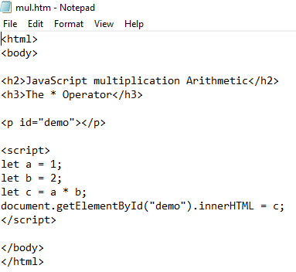
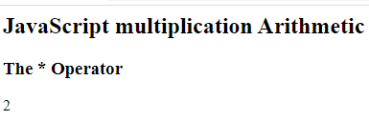
The multiplication * operator
output

Slide 47
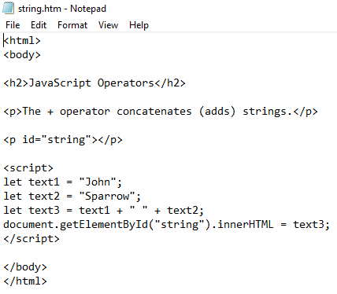
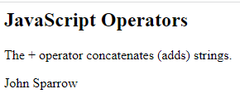
JavaScript String Operators
The + operator can be used to concatenate strings
output

Slide 48
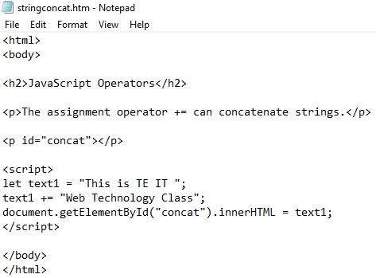
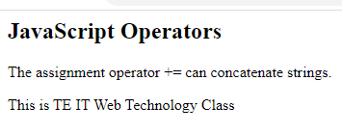
JavaScript Concatenation Operator
The += assignment operator can also be used to concatenate strings:
output

Slide 49
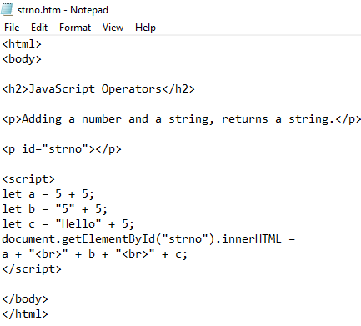
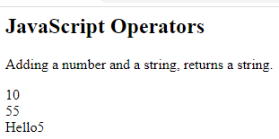
Adding Numbers and Strings
Adding two numbers, will return the sum, but adding a number and a string will return a string:
output

Slide 50
Conditional statements
In JavaScript we have the following conditional statements:
Use if to specify a block of code to be executed, if a specified condition is true
Use else to specify a block of code to be executed, if the same condition is false
Use else if to specify a new condition to test, if the first condition is false
Use switch to specify many alternative blocks of code to be executed

Slide 51
The if Statement
Use the if Statement to specify a block of JavaScript code to be executed if a condition is true.
Syntax
if (condition) { // block of code to be executed if the condition is true }
Example
Make a "Good day" greeting if the hour is less than 18:00(6 pm)
if (hour < 18) { greeting = "Good day"; }

Slide 52
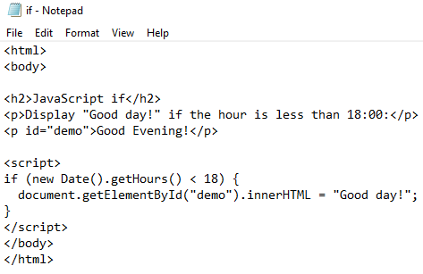
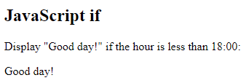
The if Statement
if.htm
output

Slide 53
The else Statement
Use the else Statement to specify a block of code to be executed if the condition is false.
Syntax
if (condition) { // block of code to be executed if the condition is true } else { // block of code to be executed if the condition is false }
Example
If the hour is less than 18, create a "Good day" greeting, otherwise "Good evening":

Slide 54
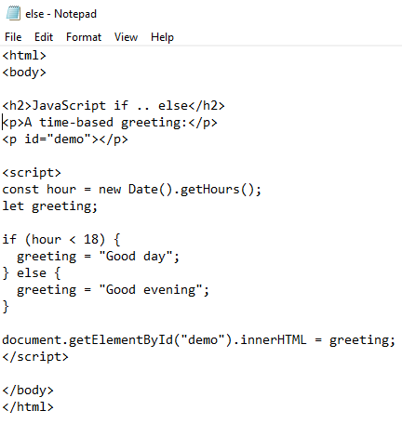
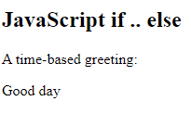
The else Statement
else.htm
output

Slide 55
The else if Statement
Use the else if Statement to specify a new condition if the first condition is false.
Syntax
if (condition1) { // block of code to be executed if condition1 is true } else if (condition2) { // block of code to be executed if the condition1 is false and condition2 is true } else { // block of code to be executed if the condition1 is false and condition2 is false }
Example
If time is less than 10:00, create a "Good morning" greeting, if not, but time is less than 20:00, create a "Good day" greeting, otherwise a "Good evening":

Slide 56
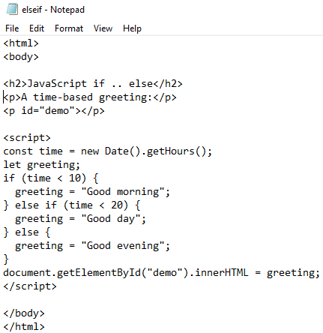
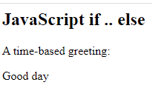
The else if Statement
elseif.htm
output

Slide 57
The JavaScript Switch Statement
Use the Switch Statement to select one of many code blocks to be executed.
Syntax
switch(expression) { case x: // code block break; case y: // code block break; default: // code block }
Example
The getDay() method returns the weekday as a number between 0 and 6.
(Sunday=0, Monday=1, Tuesday=2 ..)
Refer to switch.htm file

Slide 58
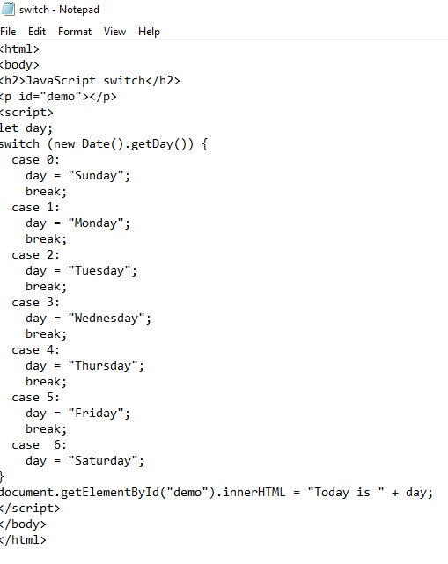

The JavaScript Switch Statement
switch.htm
output

Slide 59
Loops
JavaScript supports different kinds of loops:
for - loops through a block of code a number of times
for/in - loops through the properties of an object
for/of - loops through the values of an iterable object
while - loops through a block of code while a specified condition is true
do/while - also loops through a block of code while a specified condition is true

Slide 60
The For Loop
Syntax
for (statement 1; statement 2; statement 3) { // code block to be executed }
Statement 1 is executed (one time) before the execution of the code block.
Statement 2 defines the condition for executing the code block.
Statement 3 is executed (every time) after the code block has been executed.

Slide 61
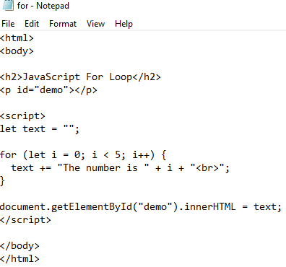
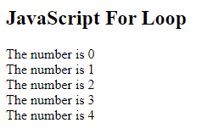
The For Loop
for.htm
output

Slide 62
JavaScript For In
The JavaScript For In statement loops through the properties of an Object
Syntax
for (key in object) { // code block to be executed }
Example Explained
The for in loop iterates over a person object
Each iteration returns a key (x)
The key is used to access the value of the key
The value of the key is person[x]

Slide 63
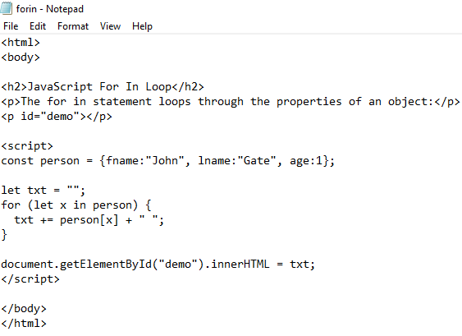
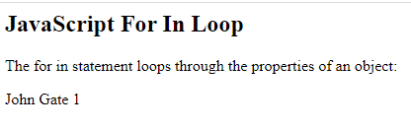
JavaScript For In
forin.htm
output

Slide 64
For In Over Arrays
The JavaScript For In statement can also loop over the properties of an Array
Syntax
for (variable in array) { code }
Example

Slide 65
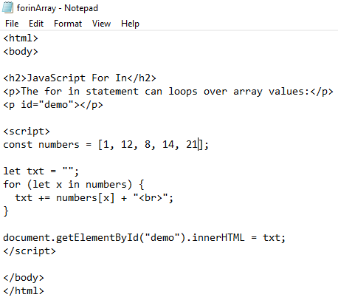
For In Over Arrays
forinArray.htm
output

Slide 66
Array.forEach()
forEach() method calls a function (a callback function) once for each array element.
Note that the function takes 3 arguments:
The item value
The item index
The array itself

Slide 67
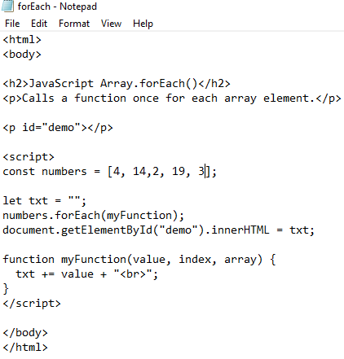
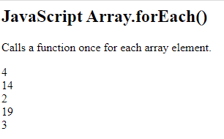
Array.forEach()
forEach.htm
output

Slide 68
JavaScript For of
The JavaScript For of statement loops through the values of an iterable object. It lets you loop over iterable data structures such as Arrays, Strings, Maps, NodeLists, and more.
Syntax
for (variable of iterable) { // code block to be executed }
variable - For every iteration the value of the next property is assigned to the variable. Variable can be declared with const , let or var
iterable - An object that has iterable properties.

Slide 69
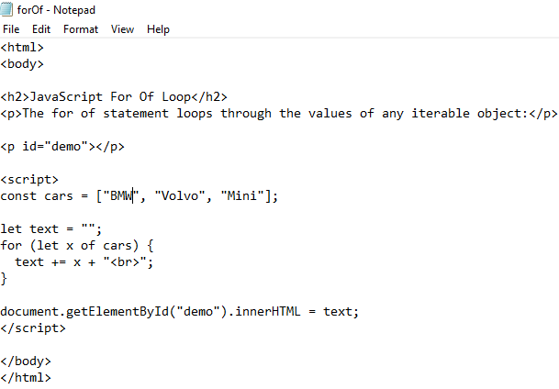
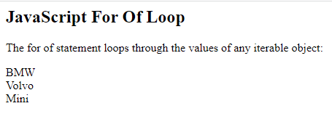
Looping over an Array
forOf.htm
output

Slide 70
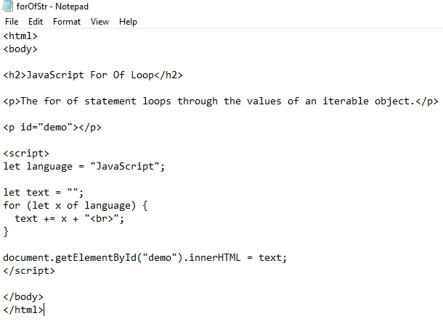
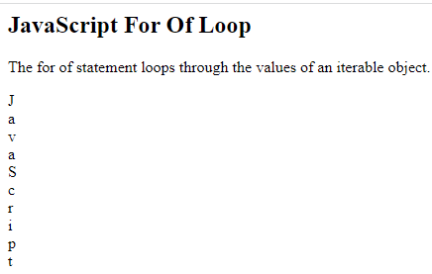
Looping over a String
forOfStr.htm
output

Slide 71
JavaScript While Loop
While Loop loops through a block of code as long as a specified condition is true.
Syntax
while (condition) { // code block to be executed }
Example

Slide 72
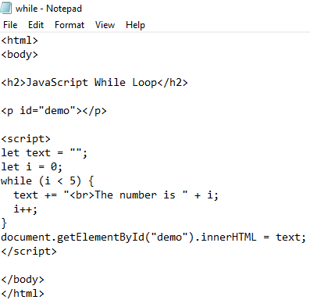
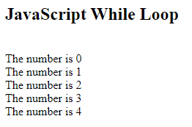
JavaScript While Loop
while.htm
output

Slide 73
The Do While Loop
The Do While Loop is a variant of the while loop. This loop will execute the code block once, before checking if the condition is true, then it will repeat the loop as long as the condition is true.
Syntax
do { // code block to be executed } while (condition);

Slide 74


The Do While Loop
doWhile.htm
output

Slide 75
JavaScript Events
HTML events are "things" that happen to HTML elements.
When JavaScript is used in HTML pages, JavaScript can "react" on these events.

Slide 76
HTML Events
An HTML event can be something the browser does, or something a user does.
Here are some examples of HTML events:
An HTML web page has finished loading
An HTML input field was changed
An HTML button was clicked
Often, when events happen, you may want to do something.
JavaScript lets you execute code when events are detected.

Slide 77
HTML Events
HTML allows event handler attributes, with JavaScript code, to be added to HTML elements.
With single quotes:
<element event='some JavaScript'>
With double quotes:
<element event="some JavaScript">

Slide 78


HTML Events
In the following example, an onclick attribute (with code), is added to a <button> element:
output

Slide 79
Common HTML Events
Sr.No | Event | Description
1 | onchange | An HTML element has been changed
2 | onclick | The user clicks an HTML element
3 | onmouseover | The user moves the mouse over an HTML element
4 | onmouseout | The user moves the mouse away from an HTML element
5 | onkeydown | The user pushes a keyboard key
6 | onload | The browser has finished loading the page

Slide 80
JavaScript Event Handlers
Event handlers can be used to handle and verify user input, user actions, and browser actions:
Things that should be done every time a page loads
Things that should be done when the page is closed
Action that should be performed when a user clicks a button
Content that should be verified when a user inputs data
...
Many different methods can be used to let JavaScript work with events:
HTML event attributes can execute JavaScript code directly
HTML event attributes can call JavaScript functions
You can assign your own event handler functions to HTML elements
You can prevent events from being sent or being handled

Slide 81
JavaScript Objects
In real life, a car is an object. A car has properties like weight and colour , and methods like start and stop. All cars have the same properties, but the property values differ from car to car.
All cars have the same methods, but the methods are performed at different times.
object | Properties | Methods
car | car.name = Fiat car.model = 500 car.weight = 850kg car.color = white | car.start() car.drive() car.brake() car.stop()

Slide 82
JavaScript Objects
Booleans can be objects (if defined with the new keyword)
Numbers can be objects (if defined with the new keyword)
Strings can be objects (if defined with the new keyword)
Dates are always objects
Maths are always objects
Regular expressions are always objects
Arrays are always objects
Functions are always objects
Objects are always objects

Slide 83
Object Definition
You define and create a JavaScript object with an object literal
Example
const person = {
firstName:"Irwin",
lastName:"Rebello",
rollno:16,
};

Slide 84


Object Definition
obj.htm
output

Slide 85
Object Properties
The named values, in JavaScript objects, are called properties.
Property | Value
firstName | Irwin
lastName | Rebello
rollno | 16

Slide 86
Accessing Object Properties
You can access object properties in two ways:
objectName.propertyName
or
2. objectName["propertyName"]

Slide 87


Accessing Object Properties using objectName.propertyName
acc1obj.htm
output

Slide 88


Accessing Object Properties using objectName["propertyName"]
acc2obj.htm
output

Slide 89
JavaScript Object Methods
Objects can also have methods.
Methods are actions that can be performed on objects.
Methods are stored in properties as function definitions.

Slide 90
What is this?
In JavaScript , this keyword refers to an object. Which object depends on how this is being invoked (used or called).this is not a variable. The this keyword refers to different objects depending on how it is used:
In an object method, this refers to the object.
Alone, this refers to the global object.
In a function, this refers to the global object.
In a function, in strict mode, this is undefined.
In an event, this refers to the element that received the event.
Methods like call(), apply(), and bind() can refer this to any object.

Slide 91


JavaScript Object Methods
this.htm
output

Slide 92
Object Methods
Property | Property Value
firstName | Yusuf
lastName | Khan
rollno | 29
fullName | function() {return this.firstName + " " + this.lastName;}

Slide 93


How to Display JavaScript Objects?
Displaying a JavaScript object will output [object Object].
displayObj.htm
output

Slide 94


Displaying Object Properties
displayObjProp.htm
output

Slide 95


Displaying the Object in a Loop
The properties of an object can be collected in a loop as shown below
displayObjloop.htm
output

Slide 96


Using Object.values()
Any JavaScript object can be converted to an array using Object.values()
displayObjArray.htm
output

Slide 97
JavaScript Functions
A JavaScript function is a block of code designed to perform a particular task. A JavaScript function is executed when "something" invokes it (calls it). A JavaScript function is defined with the function keyword, followed by a name, followed by parentheses (). Function names can contain letters, digits, underscores, and dollar signs (same rules as variables). The parentheses may include parameter names separated by commas: (parameter1, parameter2, ...)
The code to be executed, by the function, is placed inside curly brackets: {}
Function parameters are listed inside the parentheses () in the function definition. Function arguments are the values received by the function when it is invoked. Inside the function, the arguments (the parameters) behave as local variables.

Slide 98
JavaScript Function Syntax
Syntax
function name(parameter1,parameter2)
{
statement ;
statement ;
...
statement ;
}
Example
function myFunction()
{
alert("Hello!");
alert("How are you?");
}

Slide 99
Function Invocation
The code inside the function will execute when "something" invokes (calls) the function:
When an event occurs (when a user clicks a button)
When it is invoked (called) from JavaScript code
Automatically (self invoked)

Slide 100


JavaScript Functions
output

Slide 101
Function Return
When JavaScript reaches a return statement, the function will stop executing.
If the function was invoked from a statement, JavaScript will "return" to execute the code after the invoking statement.
Functions often compute a return value.
The return value is "returned" back to the "caller"

Slide 102


Function Return
output

Slide 103


Functions Used as Variable Values
Functions can be used the same way as you use variables, in all types of formulas, assignments, and calculations. Instead of using a variable to store the return value of a function. You can use the function directly, as a variable value:
output

